Slide 1
14TH Workshop “Software Engineering Education and Reverse Engineering”
Data Security in the Cloud: A Proposed Model
Dhuratë Hyseni, Betim Çiço
South East European University - Tetovo, Macedonia
dhurate.hyseni@gmail.com
b.cico@seeu.edu.mk
Sinaia, Romania
August, 2014

Slide 2
Presentation Outline
Introduction
Problem statement
Cloud security
The objectives for security in the cloud C-A-I
Data security in cloud
The proposed model for data security in cloud
Conclusion

Slide 3
Introduction
Cloud computing
Security in the cloud
Increased security
Cloud service provider

Slide 4
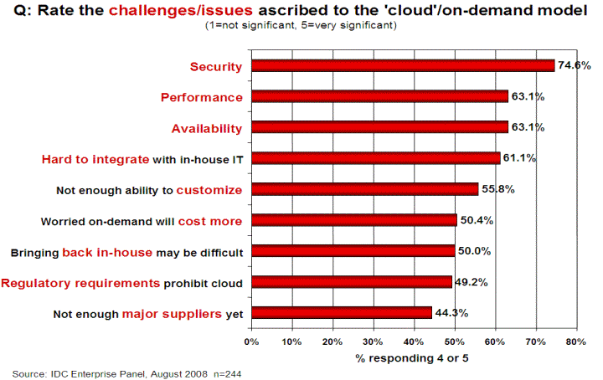
…
The issue of security in cloud has discouraged businesses to run in cloud computing
Results of IDC survey ranking security challenges, 2012
(Source: http://www.csrc.nist.gov/groups/SNS/cloud-computing)

Slide 5
PROBLEM STATEMENT
When we use cloud technology we should consider the higher security level because now our data and services should be trusted to a third party.
Important role in providing safe data in cloud offers cryptography
We propose a solution for cloud security architecture grounded elements in cryptography

Slide 6
…
During transfer of data - we proposed to use a model for encrypting the data
In our future work we will propose an algorithm which is used for data encryption
The other part of the model will include the part that the user of cloud is notified for each and every attack that occurs for data

Slide 7
Reasons of possible fails on cloud computing
Some of the main reasons of fails on cloud are as follows:
One of the reasons could can be hardware, on cloud computing is known as IaaS.
Another reason could be mistakes or better say possible fails of software, on cloud computing known as SaaS.
Disagreements of client and provider could be another reason of fail etc.

Slide 8
Cloud security
Multi-tenancy - possibility to use common resources which are offered by the provider
Escalation - possibility of escalating services and hardware that are offered on cloud
Elasticity - possibility to use resources based on the needs, when there’s a need to increase resources, if there’s no need to remove them
Pay-as-you-go- the possibility that all costumers pay as they use it

Slide 9
The objectives for security in the Cloud C-A-I
Confidentiality - protection private data of client.
Availability- the possibility to use applications on cloud computing.
Integrity- understand the client awareness that his data is placed on the cloud and unauthorized persons cannot gain access and this data is available any time we need it.

Slide 10
Sensitive rating of data
SR[i] = ( C[i] + (1/A[i] * 10 + I[i] ) ) / 4
Source (A Framework to Enhance Cryptographic Parameter for Data In Cloud, R.Sivaranjani, R.Radhika, 2014)
SR[i] = Sensitive Rating,
C[i]= Confidentiality,
A[i]= Availability,
I[i]= Integrity

Slide 11
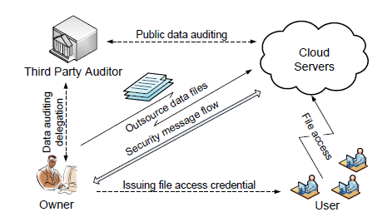
Data security in cloud computing
Data security
Data transfer
Provider
End users of the system
The manager of auditing

Slide 12
Role of cryptography in cloud
Cryptography- increase the reliability for the customers
symmetric cryptography
asymmetric cryptography
Communication between sender and receiver of the information

Slide 13
Features of cryptography
 | Simetrical cryptography | Asymetrical cryptography
Information sender | Key encryption | Private key and Public key
Informacionit reciever | Key decryption | Private key and Public key
Representer | DES (Data Encryption Standard), 3DES, RC5, RC6, Blowfish, Two-Fish AES (Advanced Encryption Standard) | RSA (Rivest Shamir Adleman) ECC (Elliptic Curve Cryptosystem)
(Source: Identity-Based Cryptography for Cloud Security, Hongwei Li1, Yuanshun Dai2 , Bo Yang3)

Slide 14
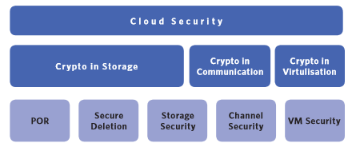
Security challenges in major areas of cloud and role of cryptography
There are some challenges that are part of the cryptography and that we will focus for propose new algorithm:
Proof of retrievability
Secure deletion in cloud
Storage security
Communication security
Virtualization security

Slide 15
The proposed model for data security
Propose model for the data security on cloud
is based on the data communication channel
data is encrypted before uploading to the server storage
users can decrypt it using button stored on the mail server at the time of encryption

Slide 16
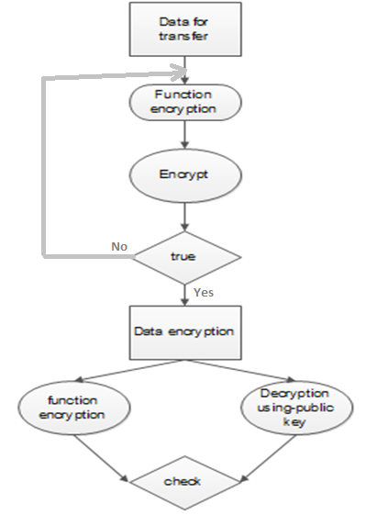
…
Model proposal of data encryption brings convenient way to store files approaches of:
secure the confidentiality,
integrity and
authentication of tests

Slide 17
…
Determined to propose the Information Dispersal Algorithm for data encrypting
We are working to propose in the future a new algorithm that can be much more reliable for the cloud computing

Slide 18
Conclusion
Making our data more secure and reliable
Building mechanisms of cryptography for the protection of data both:
during transfer and
saving in database
We proposed the model for security in the cloud based in cryptography that uses Information Dispersal Algorithm for encrypting data
All the propositions will be provided by practical examples

Slide 19
Thank you for attention!
?

